Slide 1
Analysis of three ML algorithms for training MNIST dataset
Speaker: HeZhiming
SID: 2018227154
Date: 2019-12-06
Notes:
Good afternoon everyone!
So, today, the topic I will be speaking is : Analysis of three ML algorithms for training MNIST dataset！

Slide 2
Outlines
Introduction to Three ML Algorithms (1 slide)
Selected Platforms & Toolkits (2 slides)
Project Results and Analysis (9 slides)
Discussion and Summary (2 slides)
Notes:
Here are four points of the outlines. I will explain them one by one.
The first one is Introduction to Three ML Algorithms of my choice. Just 1 slides.

Slide 3
Introduction to Three ML Algorithms
Random Forest (Supervised Algorithms)
constructing a multitude of decision trees at training time and outputting the class that is the mode of the classes (classification) or mean prediction (regression) of the individual trees.
Support Vector Machine (Supervised Algorithms)
given labeled training data (supervised learning), the algorithm outputs an optimal hyperplane which categorizes new examples.
K-means (Unsupervised Algorithms)
an iterative clustering analysis algorithm. Its steps are to randomly select k objects as the initial clustering center, then calculate the distance between each object and each seed clustering center and assign each object to the nearest clustering center.
Notes:
The two supervised algorithms I chose are Random Forest and Support Vector Machine.
And I chose the K-means algorithm as my task for unsupervised learning

Slide 4
Outlines
Introduction to Three ML Algorithms (1 slides)
Selected Platforms & Toolkits (2 slides)
Project Results and Analysis (9 slides)
Discussion and Summary (2 slides)
Notes:
Second, I will explain the operating environment and toolkit of my choice.

Slide 5
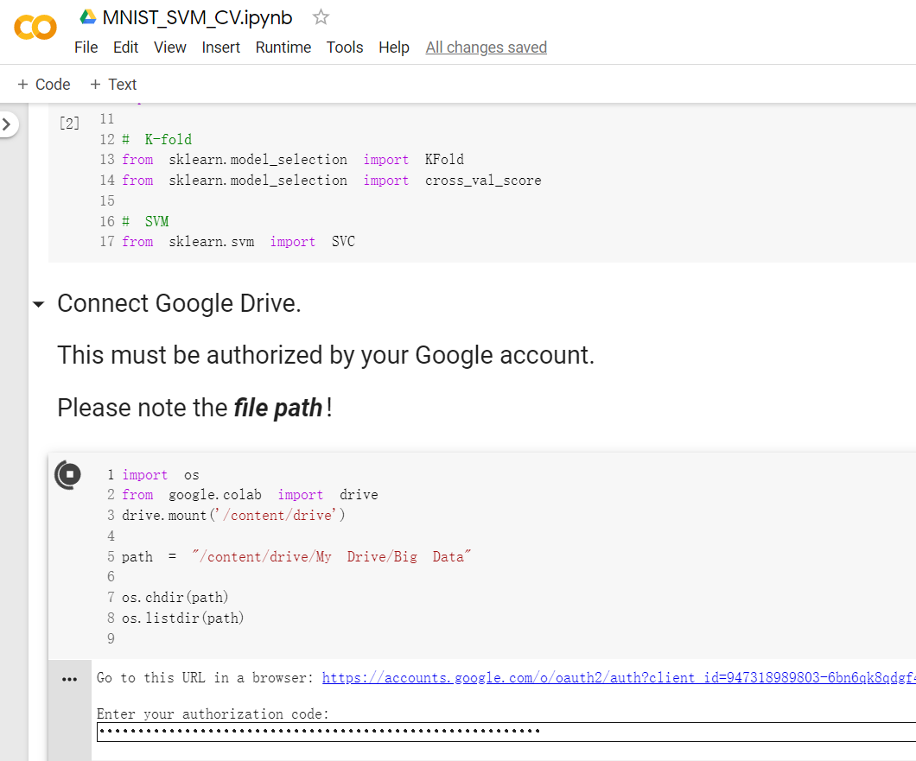
Selected Platforms & Toolkits
Google Colaboratory (Colab)
Jupyter Notebook
Can train ML models in the cloud
Supports Python3 and Python2
Provides GPU or TPU processor to quicken learning speed
Source code and datasets are stored in Google Drive for easy access
Notes:
Because my computer performance is not good, I think it will take me a lot of time to running, so I chose to run my code on Google's Colab platform.

Slide 6
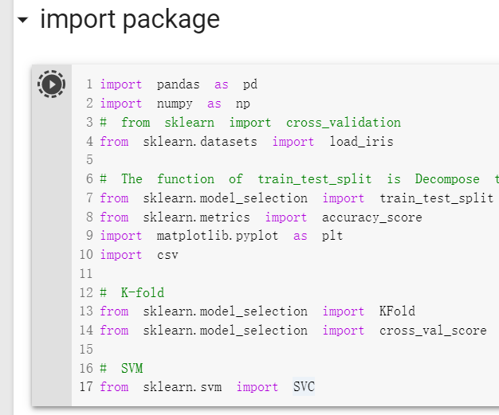
Selected Platforms & Toolkits (cont.)
Scikit-Learn (sklearn)
Well-known and open source python machine learning package
Simple and efficient tools for predictive data analysis
Accessible to everybody, and reusable in various contexts
Built on NumPy, SciPy, and matplotlib
Notes:
For the toolkit, I used Scikit-Learn. in class, professor used this machine learning package. I refactored and modified the professor‘s code in Google’s Colab, and got the results.

Slide 7
Outlines
Introduction to Three ML Algorithms (1 slides)
Selected Platforms & Toolkits (2 slides)
Project Results and Analysis (9 slides)
Discussion and Summary (2 slides)
Notes:
OK, next one is the key of my project. I have three slides for each algorithm result

Slide 8
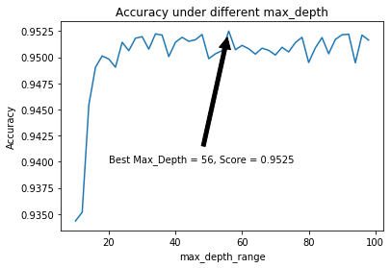
Project Results and Analysis – Random Forest
Parameter Tuning for max_depth
( Built on n_estimators = 20)
max_depth_range = range(10,101,2)
Accuracy range: (0.9350, 0.9525]
When max_depth is from 10 to 30, the accuracy increases greatly!
When max_depth is from 30 to 100, the accuracy are up and down motion, not the larger the better!
Notes:
The first is random forest. I did parameter tuning for the maximum depth of the decision tree.
Max_depth ranges from 10 to 100 and The step is 2.
Look at this picture. We can find : When max_depth is from 10 to 30, the accuracy increases greatly!
But When max_depth is from 30 to 100, the accuracy up and down motion, not the larger the better!
The best max_depth is 56

Slide 9
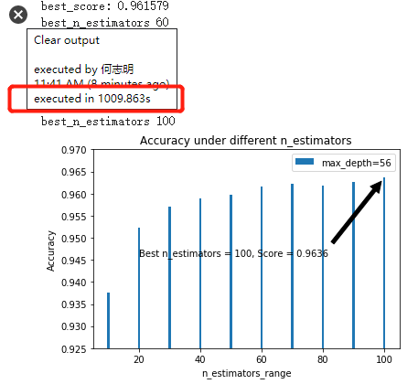
Project Results and Analysis – Random Forest (cont.)
Parameter Tuning for n_estimators
( Built on max_depth = 56)
n_estimators_range= range(10,101,10)
Accuracy range: (0.9357, 0.9637]
When n_estimators is from 10 to 100, the accuracy increases.
In general, n_estimators are too small, and the model will be underfitting. But if n_estimators is too large, and the amount of calculation will be too large!
executed in 1009.863s
Notes:
Second, I did parameter tuning for the Maximum number of iterations，that is n_estimators.
for this parameter tuning for n_estimators, It‘s based on max_depth equals 56.
From result figure，we can find， When n_estimators is greater than 60, the accuracy increase is not good, but it is still increasing slowly.

Slide 10
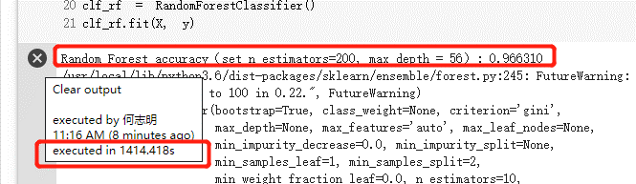
Project Results and Analysis – Random Forest (cont.)
set n_estimators=200, max_depth = 56
The value of n_estimators has doubled
But the accuracy only increased by 0.02!
Execution time is nearly half of the last round of tests (10 sets of results)
executed in 1414.418s
Notes:
In the end, I set the n_estimators to 200, and the accuracy was only improved by 0.2 percent。
But execution time has increased very large

Slide 11
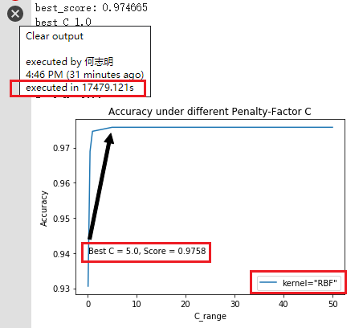
Project Results and Analysis – Support Vector Machine
Parameter Tuning for Penalty-Factor C
( Built on kernel = “RBF”)
C_range = np.array([0.1, 0.5, 1, 5, 10, 50])
Accuracy range: (0.9306, 0.9758]
When C is from 0.1 to 5, the accuracy increases. But after 5 (5, 10, 50), the accuracy has not changed.
Execution time is TOO LONG!
executed in 17479.121s
Notes:
Second is Support Vector Machine 。 First, I tuned for parameter penalty factor C.
This figure is show us, When C is from 0.1 to 5, the accuracy increases. But after 5 the accuracy has not changed.
Please note that，the Execution time is TOO LONG!

Slide 12
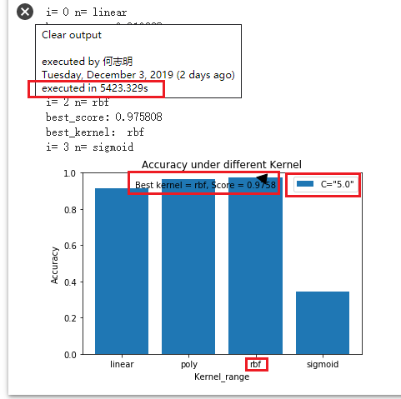
Project Results and Analysis – Support Vector Machine (cont.)
Parameter Tuning for Kernel
( Built on Penalty-Factor C = 5.0)
Kernel_range =
np.array(['linear’, 'poly', 'rbf ' , 'sigmoid’])
Accuracy range: (0.327, 0.9758]
The sigmoid kernel function is completely unsuitable for MNIST data set, and its accuracy is very low!
The best kernel function is the Radial Basis Function kernel.
executed in 5423.329s (90 min)
Notes:
Next, I tuned the kernel function。
The best kernel function is the RBF kernel. And Accuracy reached 97%.
But, for sigmoid kernel function ， it is completely unsuitable for MNIST data set, and its accuracy is very low!
For the time, we got Four results, spend 90 minutes

Slide 13
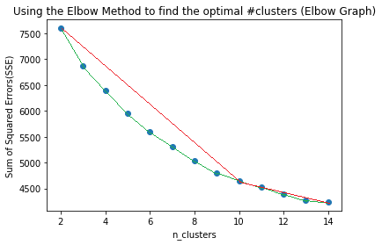
Project Results and Analysis – K-Means
Find the optimal # clusters
K_Range = range (2, 15)
From the reference line I added in this figure, it can be found that when k = 10, it is the point of inflection.
Notes:
For KMeans，The first step is to find the optimal number of clusters。
I used elbow method ，this figure is Elbow graph, and The range of K is 2 to 15

Slide 14
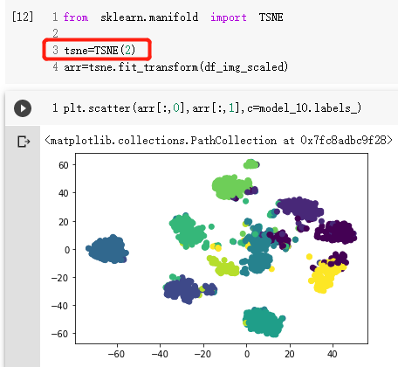
Project Results and Analysis – K-Means (cont.)
Applied t-SNE (Stochastic Neighbors Embedding) to reduce the dimensions of the dataset
we should remember that k-means is not a classification tool, thus analyzing accuracy is not a very good idea. It is supposed to find a grouping of data which maximizes between-clusters distances, it does not use labeling to train.
Notes:
we should remember that k-means is not a classification tool, thus analyzing accuracy is not a very good idea.
So, I Applied t-SNE to reduce the dimensions of the dataset。

Slide 15
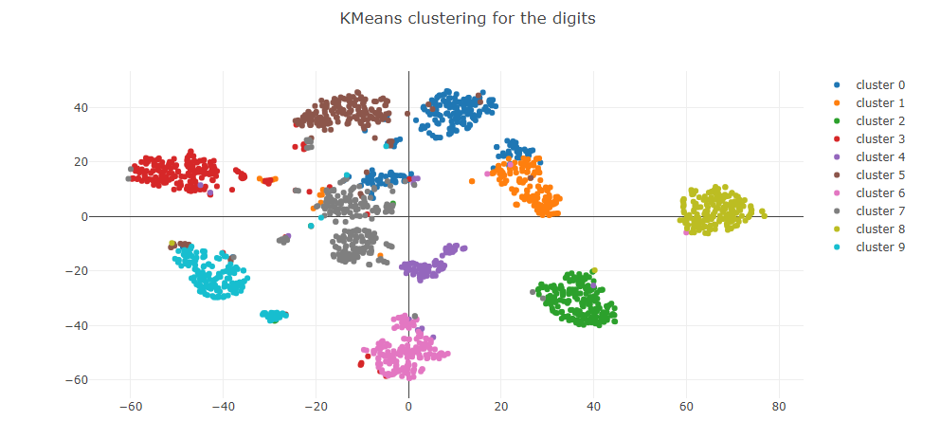
Project Results and Analysis – K-Means (cont.)
graph the resulting clusters in a 2D scatter plot using matplotlib and plotly
Notes:
We got the clusters in a 2-dimensional scatter diagram ，like this.

Slide 16
Outlines
Introduction to Three ML Algorithms (1 slides)
Selected Platforms & Toolkits (2 slides)
Project Results and Analysis (9 slides)
Discussion and Summary (2 slides)
Notes:
Finally, it is discussion and summary

Slide 17
Discussion and Summary
I can clearly feel that the running time of the SVM is very long compared to the other two algorithms, and it is estimated that it can reach a gap of a hundred times, but the accuracy of the SVM is really high. When the model is running, I specifically set it to reduce the running time. test_size = 0.7 in the train_test_split function, but the accuracy can still reach 97.58%, which is better than others.
SO, Through this project, I summarized three rules:
For Random Forest: Able to train good results on large data sources in a relatively short time.
Notes:
This is the first time I learned this three algorithms.
Through this project, I summarized three rules:
For Random Forest: it Able to train good results on large data sources in a relatively short time.

Slide 18
Discussion and Summary (cont.)
SO, Through this project, I summarized three rules:
For Support Vector Machine: When there are many training samples, the efficiency is not very high, but accuracy is better. And it is very important to choose the right kernel function (Accuracy of sigmoid is just 32.7%, accuracy of rbf is 97.6%).
For K-Means: Algorithm is very fast! The key point in this algorithm is to find the k partitions that minimize the value of the squared error function.
Notes:
For Support Vector Machine: When there are many training samples, the efficiency is not very high, but accuracy is better. And it is very important to choose the right kernel function
For K-Means: Algorithm is very fast! The key point in this algorithm is to find the k partitions that minimize the value of the squared error function.

Slide 19
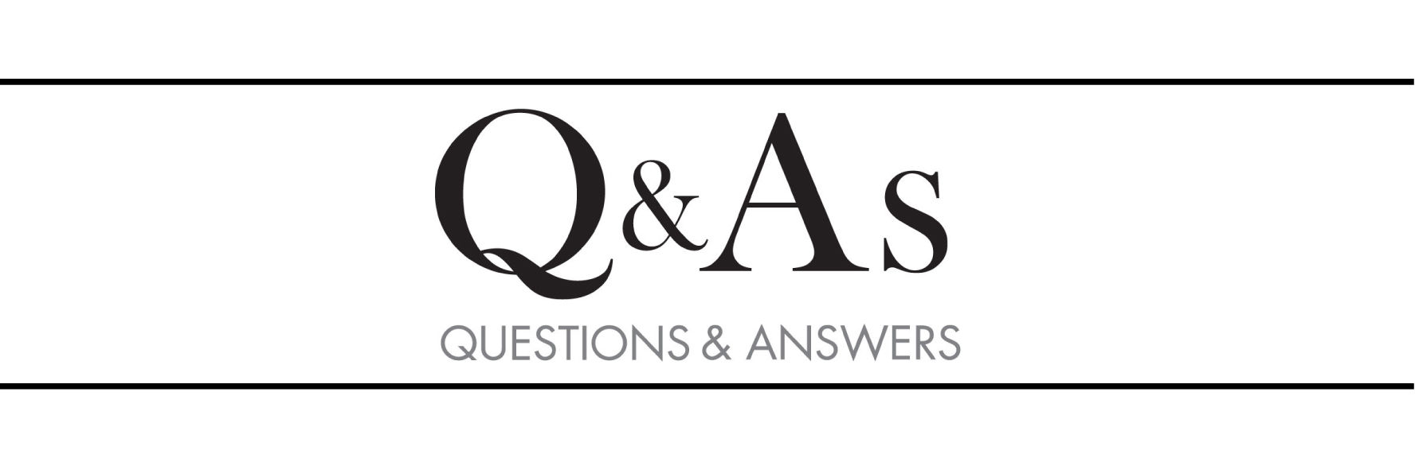

Notes:
Ok, that’s all. Thank you for your listening! Thank you so much! Any question?

